Slide 1
FRB Update #30
William Huang
(08/07/2021)

Slide 2
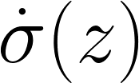
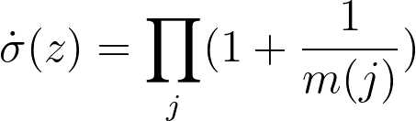
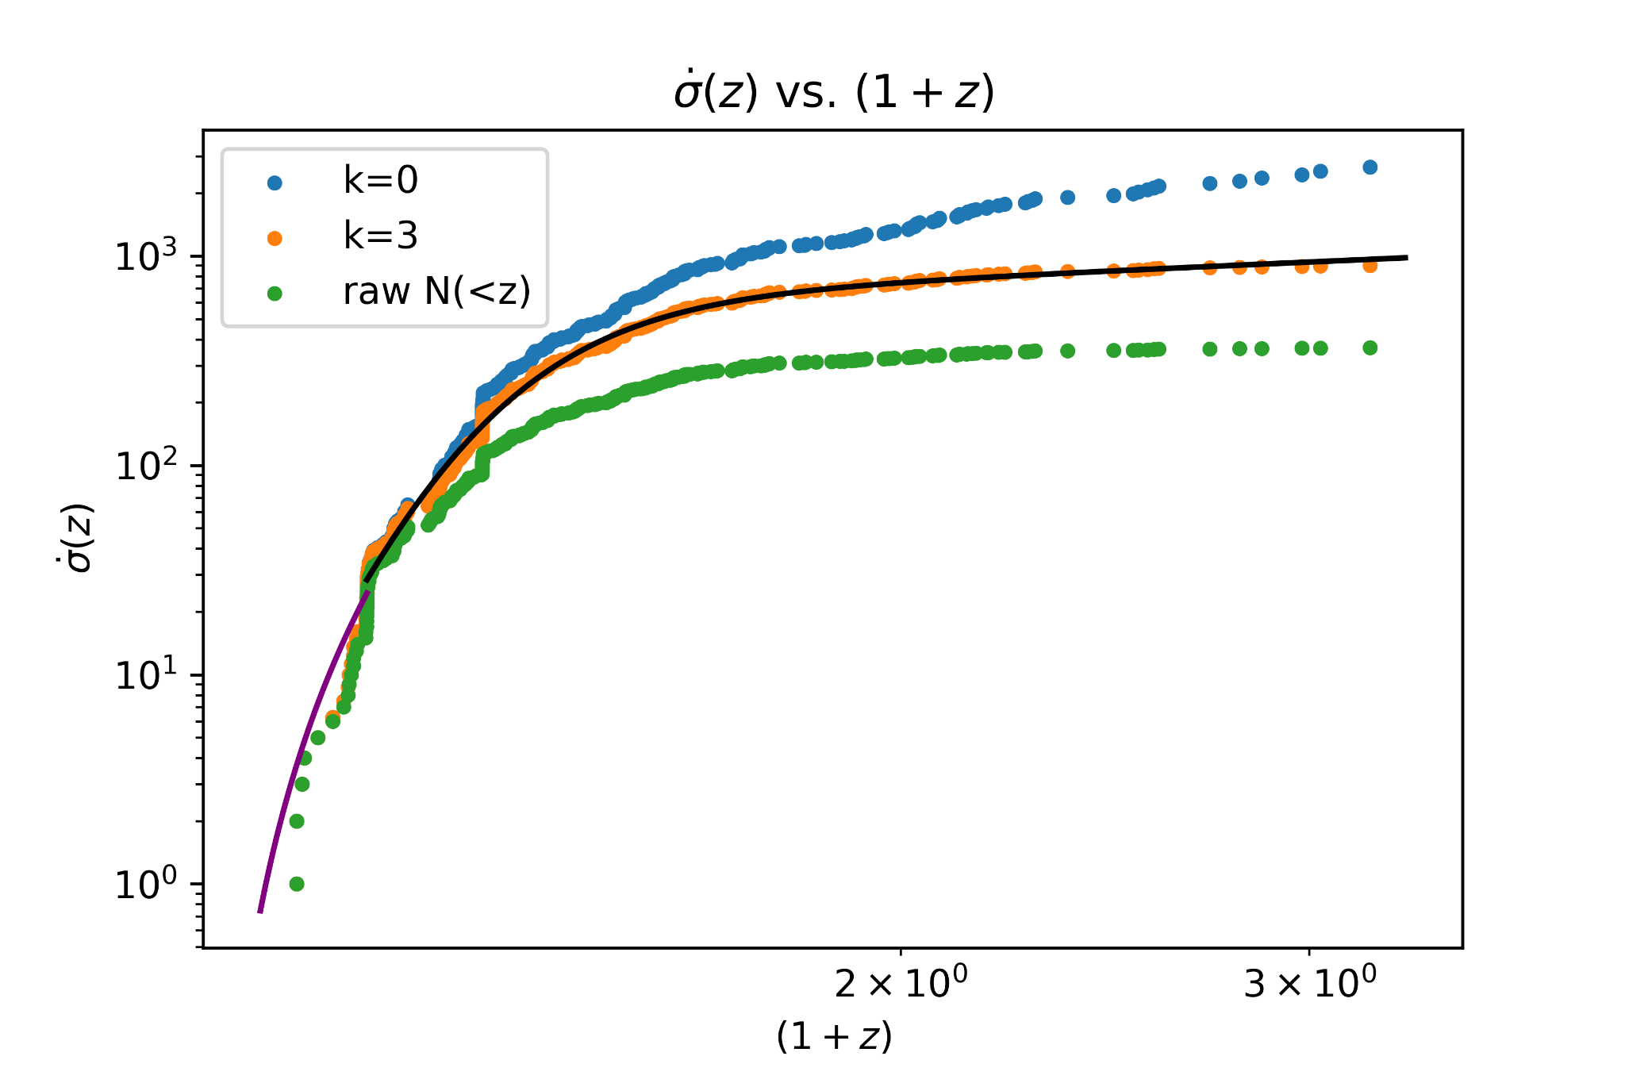
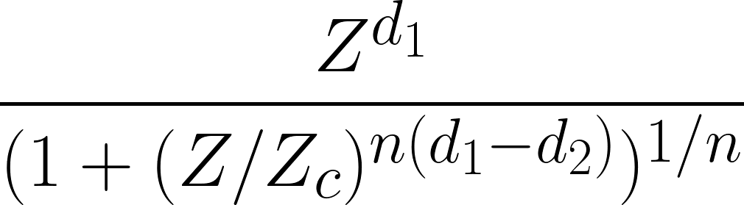
Using the formula to the right, I plotted for k=0 and k=3, comparing this to the raw distribution of FRBs with redshift N(<z).
For k=3, I fit a power law to the first few points and the following function to the rest of the points:

Slide 3

(cont.)
The results of the fits were as follows
, p = 3.2 (for the first few points)
d₁ = 26.68, d₂ = 0.486, Z_{c} = 1.272, n = 0.375

Slide 4
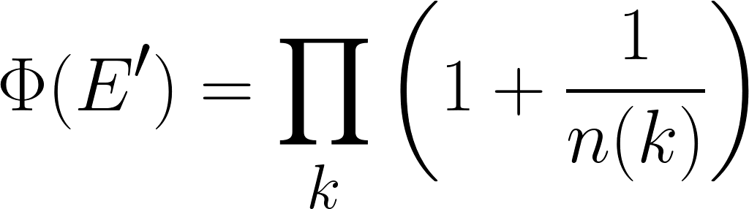
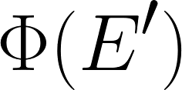
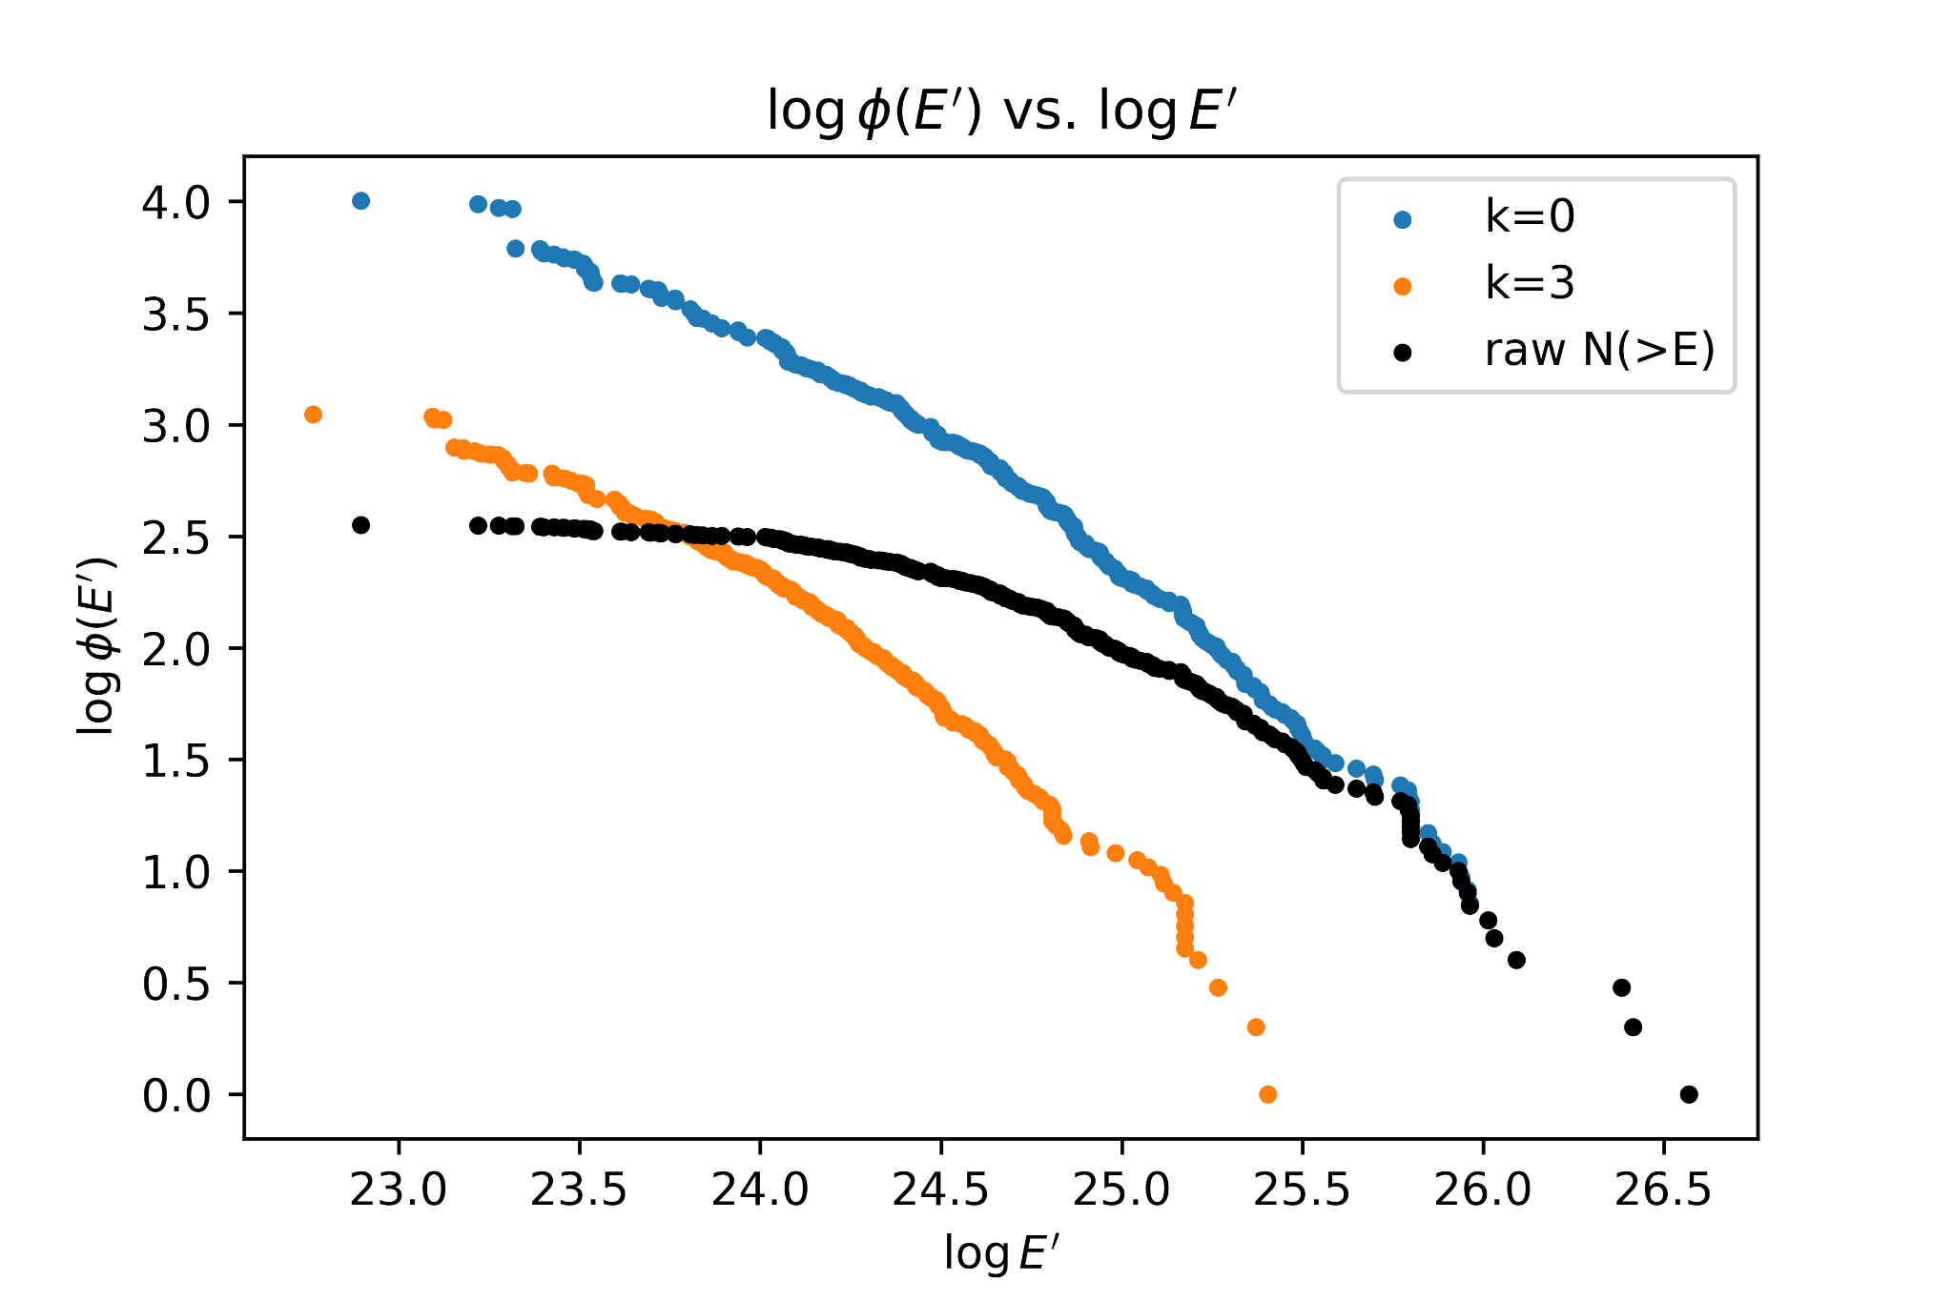
Using the formula on the right, I plotted for k=0 and k=3, comparing it to the raw N(>E), and as expected k=0 is always greater than the raw distribution.
For k=3, the line is shifted to the left because E has been transformed to E’ through g(z)=(1+z)³.

Slide 5
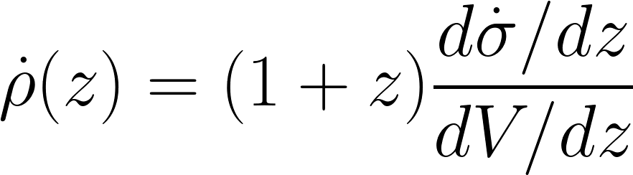
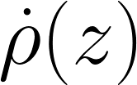
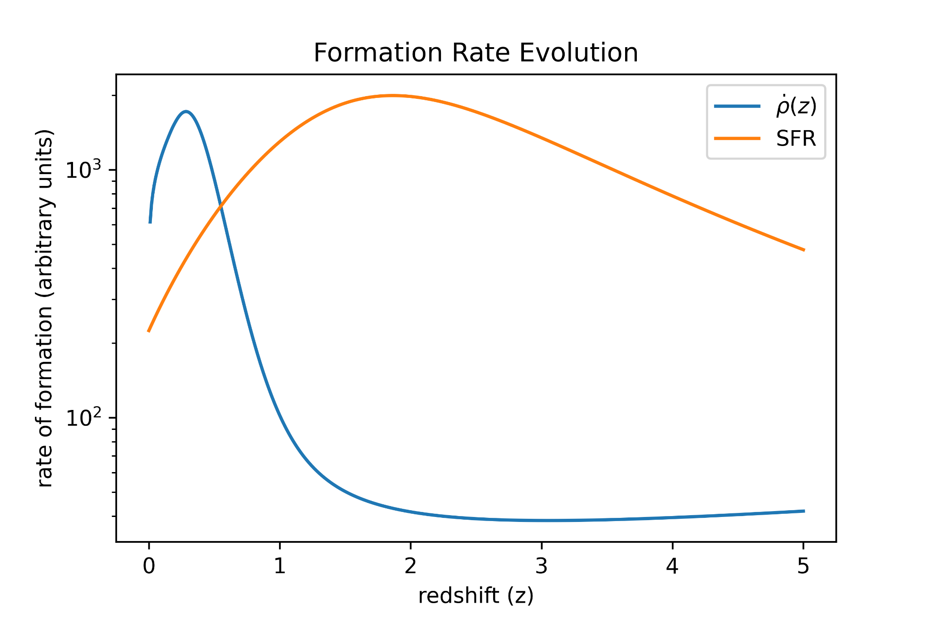
Using and assuming k=3, I calculated the formation rate evolution with the formula on the right. In order for not to approach infinity as z → 0, I fit the first few points of with a power law, guaranteeing a derivative of 0 as z → 0.
A comparison with the star formation rate shows that the formation of FRBs peaks at low z.

